Slide 1
IBM University Engagement Project Submission
Smart Business Idea Generator Agent

Slide 2

Project Tile – Smart Business Idea Generator Agent
Domain of Project – Business
Faculty Name | Recent Passport Photo | Email ID | Mobile number [WhatsApp]
PRAMILA VIKAS BHAGWAT |  | pramilabhagwat1980@gmail.com | 7498035232

Slide 3
Problem Statement -
Problem Statement : Smart Business Idea Generator Agent
The Challenge
In the digital era, innovation is crucial, but individuals, students, researchers, and organizations often struggle with idea generation. Brainstorming sessions are unstructured, inspiration is scattered across articles, videos, and social media, and existing tools focus on text-only prompts without context-awareness. The challenge is not just to suggest random ideas but to synthesize creativity, context, and relevance into intelligent, actionable ideas for diverse domains such as startups, research, content creation, or product development.
The Objective
Build an agentic AI Smart Idea Generator that empowers users with contextual, innovative, and multimodal ideation. The solution should:
Fuse Knowledge Sources: Pull insights from articles, research papers, trend analysis, and social platforms to generate contextual and current ideas.
Enable Multimodal Brainstorming: Accept inputs like text prompts, images (e.g., product sketches), or voice notes and refine them into structured, creative suggestions.
Create a Predictive & Agentic Layer: Identify trending domains (e.g., AI in healthcare, sustainable energy), forecast idea relevance, and recommend high-impact directions.
Visualize Idea Maps: Provide an interactive dashboard that organizes ideas into categories, impact scores, and feasibility maps, helping users explore and refine concepts quickly.

Slide 4
Technology Used
IBM Watsonx/ IBM Orchestrate + IBM Models

Slide 5
Proposed Solution -
Proposed Solution: AI-Smart Business Idea Generator Agent
The Smart Business Idea Generator Agent is an AI-powered system designed to help people identify the best business opportunities based on their personal skills, interests, available budget, and current market trends. Many individuals want to start a business, but they often face difficulties in choosing the right idea because they lack proper guidance, market knowledge, or understanding of profitable opportunities. This creates confusion and increases the risk of failure.
To solve this problem, the Smart Business Idea Generator Agent works as an intelligent assistant that collects important information from users, such as their investment capacity, experience, interests, preferred industry, and business goals. After analyzing this information, the agent studies market demand and identifies business opportunities that have strong profit potential and future growth.
The system then generates personalized business ideas that match the user’s situation. It can recommend different types of businesses such as online businesses, small startups, service-based businesses, e-commerce stores, technology startups, freelance businesses, and side hustle opportunities. Along with idea generation, the agent also provides suggestions about target customers, estimated startup cost, expected profit, competition level, and possible risks.
In addition, the agent helps users understand how to start the business by providing step-by-step guidance, suitable business models, marketing strategies, and growth plans. It also helps users validate whether the business idea is practical and sustainable in the current market.
By using artificial intelligence and market analysis, the Smart Business Idea Generator Agent reduces uncertainty, saves research time, and helps entrepreneurs make better decisions. It acts like a personal business advisor that supports users in finding innovative, profitable, and realistic business opportunities, making the journey of starting a business easier and more successful.

Slide 6
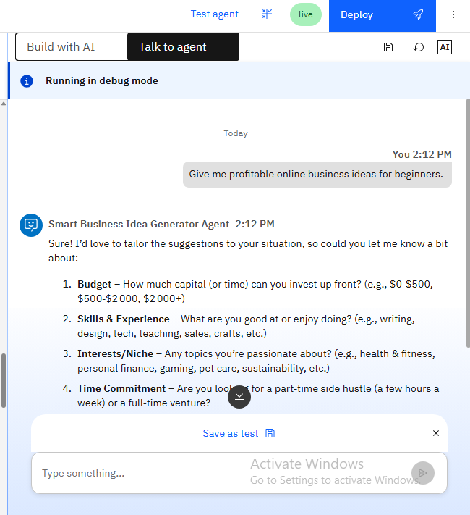
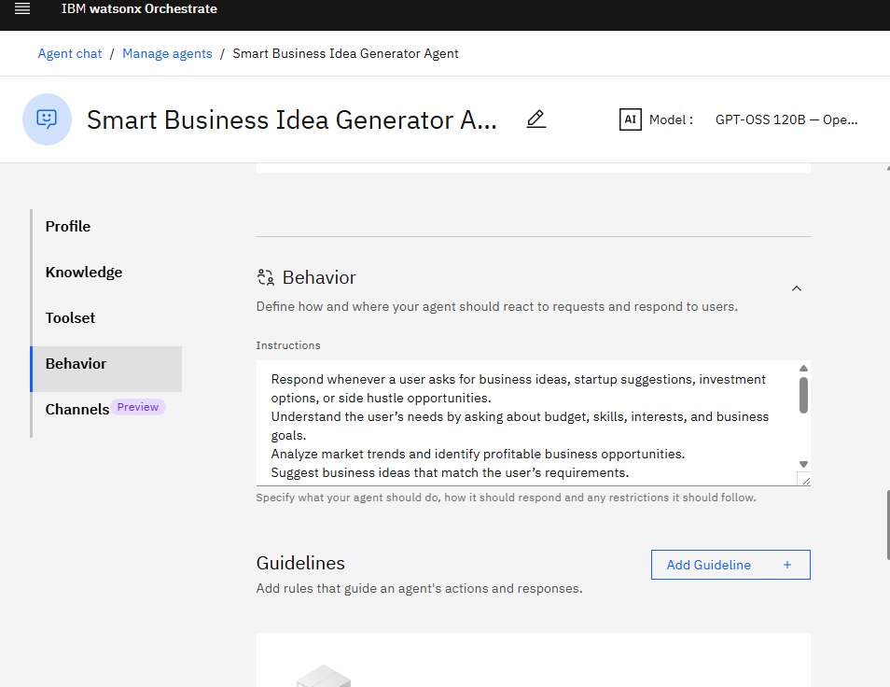

Slide 7

Architecture blueprint

Slide 8

Role of Agentic AI in the solution
Role of Agentic AI in Smart Business Idea Generator Agent
Agentic AI plays an important role in the Smart Business Idea Generator Agent by acting as an intelligent decision-making system that can understand user needs, analyze information, and provide personalized business suggestions without constant human guidance. Unlike traditional systems that only provide fixed answers, Agentic AI can think, learn, and make smart decisions based on different situations.
In this solution, Agentic AI first interacts with the user and collects important details such as budget, skills, interests, experience, and business goals. It then analyzes this information and studies current market trends, customer demand, competition, and profitable business opportunities. Based on this analysis, the AI agent generates personalized business ideas that best match the user’s requirements.
The agent can also compare multiple business options and suggest the most profitable and practical one. It helps users understand startup costs, target customers, risks, and future growth possibilities. If the user changes requirements, the AI can quickly adapt and provide new recommendations.
Another important role of Agentic AI is continuous guidance. It not only generates business ideas but also helps in planning business models, marketing strategies, and step-by-step execution plans. The system works like a virtual business advisor that supports entrepreneurs throughout the decision-making process.
By using Agentic AI, the solution becomes smarter, faster, and more personalized. It reduces confusion, saves research time, improves decision-making, and helps users confidently choose the right business opportunity for success.

Slide 9
Technology Used
IBM Watsonx Orchestrate -For designing and orchestrating multi-agent workflows visually
IBM Grainte model - for eg – ibm-granite-3-2-8b – For natural language understanding, reasoning, and personalization
IBM Cloud – It provides the infrastructure to build, deploy, and scale the Nutrition Agent efficiently. IBM Cloud enables a reliable, secure, and scalable environment for deploying the Nutrition Agent.
IBM Watsonx.ai - For model deployment, embeddings, and AI governance

Slide 10
Novelty and Uniqueness
The Smart Business Idea Generator Agent is unique because it gives personalized business ideas based on user skills, interests, and budget.
It uses AI to analyze market trends and identify profitable opportunities.
Unlike traditional systems, it provides customized suggestions for each user.
It helps users choose business ideas with low risk and high profit potential.
The system can compare multiple business options intelligently.
It adapts when user requirements change and gives new recommendations.
It provides startup planning and business growth guidance.
It reduces time spent on market research and decision-making.
The use of Agentic AI makes the system smarter and more interactive.
It acts like a virtual business advisor for future entrepreneurs.

Slide 11
Git Hub Link
Github URL –
https://github.com/pramilabhagwat1980/Smart-Business-Idea-Generator-Agent-.git
·
·
·

Slide 12
Future Scope
The Smart Business Idea Generator Agent can be improved by adding more advanced AI features for better business suggestions.
It can provide real-time market trend analysis for accurate recommendations.
The system can be connected with financial tools to estimate profit and investment needs.
It can suggest business ideas based on local market demand and customer behavior.
Future versions can include competitor analysis and risk prediction features.
The agent can support multiple languages for wider accessibility.
It can help users create complete business plans automatically.
Integration with platforms like Google Trends can improve market research.
It can guide users in marketing and scaling their business.
In the future, it can become a complete virtual business advisor for entrepreneurs.
·
·

Slide 13


